Slide 1
Extracting Causal Relations from Electronics & Supply Chain News
Fiona Anting Tan Institute of Data Science National University of Singapore, Singapore tan.f@u.nus.edu
09 March 2023
Notes:
To extract the hidden pattern in data to understand the interrelation between factors—in future to establish causality

Slide 2
Introduction & Motivation
Problem Statement: How can we monitor the causal chains of events in news? How can we track if certain events will be of impact to Panasonic?
Current process at Panasonic: Users read through news articles and label the news’ impact on Panasonic (Negative (1) – Positive (5) impact)
Can we do better? Can we automate the identification of causal chains of events in news?
Negative (1) – Positive (5)
2035 ban on petrol, diesel cars
China Considers Extending its EV Subsidies to 2023
News Articles
Notes:
Article level ratings, not granular enough to explain WHICH EVENT matters.
By storing a KG of causes and effects, we can use it for summarization and hypothesis generation applications, discussed later.

Slide 3

Overview
Cause
Effect
The Tata Avinya concept car is unveiled during a global launch event in Mumbai, India, April 29, 2022. The first electric vehicles (EVs) built using its new platform should be on the road in 2025, Tata (TAMO.NS) said during an event in Mumbai where it unveiled a concept model. Tata is striving to position itself alongside global automakers that are investing billions of dollars to build EVs that meet stricter carbon reduction goals. Our
is to go global eventually…
Fifteen countries have agreed to work together toward 100% zero-emission new truck and bus sales by 2040. Participants in this coordinated global effort agree that zero-emission trucks and buses are essential to reducing transport emissions, mitigating climate change, improving air quality, reducing the use of fossil fuels and energy costs. The Global Agreement on Zero-Emission Trucks and Buses builds on previous action and ambition from key government …
the chip crisis and the surge in Covid cases in some parts of the world
Global car manufacturers like Toyota Motor Corp and Ford Motor Corp have decided to slash production sharply
News Articles
Causal Relations
Causal Knowledge Graph

Slide 4
Overview
Cause
Effect
The Tata Avinya concept car is unveiled during a global launch event in Mumbai, India, April 29, 2022. The first electric vehicles (EVs) built using its new platform should be on the road in 2025, Tata (TAMO.NS) said during an event in Mumbai where it unveiled a concept model. Tata is striving to position itself alongside global automakers that are investing billions of dollars to build EVs that meet stricter carbon reduction goals. Our
is to go global eventually…
Fifteen countries have agreed to work together toward 100% zero-emission new truck and bus sales by 2040. Participants in this coordinated global effort agree that zero-emission trucks and buses are essential to reducing transport emissions, mitigating climate change, improving air quality, reducing the use of fossil fuels and energy costs. The Global Agreement on Zero-Emission Trucks and Buses builds on previous action and ambition from key government …
the chip crisis and the surge in Covid cases in some parts of the world
Global car manufacturers like Toyota Motor Corp and Ford Motor Corp have decided to slash production sharply
News Articles
Causal Relations
Causal Knowledge Graph
6384 articles
62,151 sentences
6613 relations from 6876 sentences
5943 relations
3836 nodes
Clustering & Representation
Extraction

Slide 5
Extraction
Pattern-based (CauseNet - Heindorf et al., 2020)
Identify shortest dependency path between two nouns
Identify as causal based on a list of causal linguistic patterns
“Honda blamed delays in receiving parts and logistics due to COVID-19 and semiconductor shortages.”
shortages → delays in receiving parts and logistics
[[cause]]/N -nmod:due receiving/VBG +obj [[effect]]/N
Notes:
shortages;;delays;;16;;3;;[[cause]]/N -nmod:due receiving/VBG +obj [[effect]]/N;;1;;1;;1;;18;;Honda blamed delays in receiving parts and logistics due to COVID - 19 and semiconductor shortages .;;1
shortages;;parts;;16;;6;;[[cause]]/N -nmod:due receiving/VBG +obj [[effect]]/N;;1;;1;;1;;18;;Honda blamed delays in receiving parts and logistics due to COVID - 19 and semiconductor shortages .;;1
shortages;;logistics;;16;;8;;[[cause]]/N -nmod:due receiving/VBG +obj [[effect]]/N;;1;;1;;1;;18;;Honda blamed delays in receiving parts and logistics due to COVID - 19 and semiconductor shortages .;;1

Slide 6
Extraction
Neural network-based (UniCausal - Tan et al., 2022)
Taking pre-trained models trained on the task of Causal Sentence Classification and Cause-Effect Span Detection on external datasets, we directly identify the spans in Causal sentences.
“Honda blamed delays in receiving parts and logistics due to COVID-19 and semiconductor shortages.”
COVID-19 and semiconductor shortages → Honda blamed delays in receiving parts and logistics
Notes:
<ARG1>Honda</ARG1> blamed <ARG1>delays in receiving parts and logistics</ARG1> due to <ARG0>CO ##VI ##D - 19 and semi ##conductor shortages .</ARG0>

Slide 7
Extraction
Causal Relations
6613 relations
6876 sentences
Cause Span | Effect Span | Evidence
to get similar to the low cost available in China . | " A U . S . facility would need a better U . S . supply chain | "A U.S. facility would need a better U.S. supply chain to get similar to the low cost available in China."
they don ' t have the cash reserves | " The smaller borrowers , especially those in manufacturing are really suffering this time round | "The smaller borrowers, especially those in manufacturing are really suffering this time round, because they don't have the cash reserves," she said.
to produce good , low - cost , and high - performance batteries | " We are focusing on safety , long service life , and high - level quality | "We are focusing on safety, long service life, and high-level quality to produce good, low-cost, and high-performance batteries," Maeda said.
the chip crisis and the surge in Covid cases in some parts of the world . | Global car manufacturers like Toyota Motor Corp and Ford Motor Corp have decided to slash production sharply | Decoded | Impact of semiconductor chip shortage on global economyGlobal car manufacturers like Toyota Motor Corp and Ford Motor Corp have decided to slash production sharply in the wake of the chip crisis and the surge in Covid cases in some parts of the world.
Notes:
Some examples, the spans are all quite sound
Qn now is how to group the Spans == Nodes?

Slide 8
Overview
Cause
Effect
The Tata Avinya concept car is unveiled during a global launch event in Mumbai, India, April 29, 2022. The first electric vehicles (EVs) built using its new platform should be on the road in 2025, Tata (TAMO.NS) said during an event in Mumbai where it unveiled a concept model. Tata is striving to position itself alongside global automakers that are investing billions of dollars to build EVs that meet stricter carbon reduction goals. Our
is to go global eventually…
Fifteen countries have agreed to work together toward 100% zero-emission new truck and bus sales by 2040. Participants in this coordinated global effort agree that zero-emission trucks and buses are essential to reducing transport emissions, mitigating climate change, improving air quality, reducing the use of fossil fuels and energy costs. The Global Agreement on Zero-Emission Trucks and Buses builds on previous action and ambition from key government …
the chip crisis and the surge in Covid cases in some parts of the world
Global car manufacturers like Toyota Motor Corp and Ford Motor Corp have decided to slash production sharply
News Articles
Causal Relations
Causal Knowledge Graph
6384 articles
62,151 sentences
6613 relations from 6876 sentences
5943 relations
3836 nodes
Clustering & Representation
Extraction

Slide 9
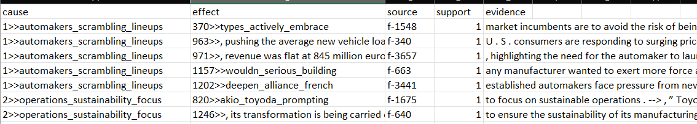
Clustering
Causal Knowledge Graph
5943 relations
3836 nodes
The main idea is to generate embeddings where semantically similar spans can be clustered together.
Remove named-entities from span. Generate BERT-based word embeddings from each span (SimCSE – Gao et al., 2021)
Cluster spans using K-Means
To display words for nodes, use TF-IDF to find keywords per topic. For nodes with only 1 span, we use the span directly.
Notes:
SimCSE, shown to work well on semantic textual similarity (STS) tasks
Trained by a contrastive learning framework
Using “entailment” pairs as positives and “contradiction” pairs as hard negatives.
Some filtering done to drop infrequent nodes (E.g. node weight >5, edge degree >3)

Slide 10
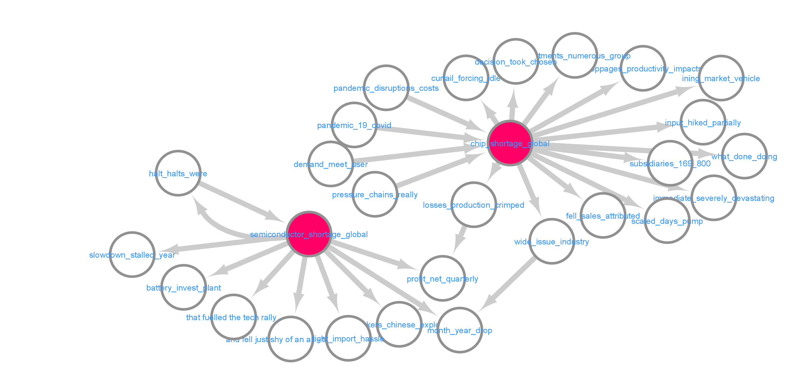
Working example: Search “shortage” as root node
Notes:
D:\66 CausalMap\SciLit_CausalMap\visualization\mir_nerclust
Orange box = common effect, “shortage → in month year drop, in quarterly net profits”
Note: there are more nodes with the word “shortage”, just showing 2 here for easier discussion

Slide 11
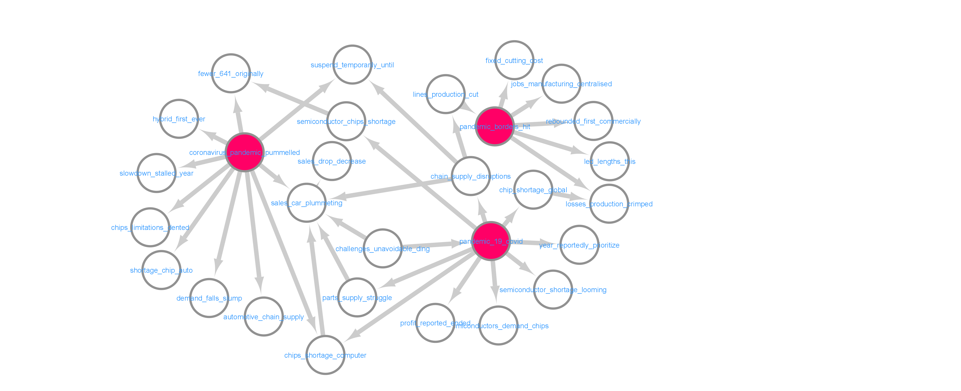
Working example: Search “pandemic” as root node
Notes:
D:\66 CausalMap\SciLit_CausalMap\visualization\mir_nerclust
Second/third degree impacts of pandemic → sales drop

Slide 12
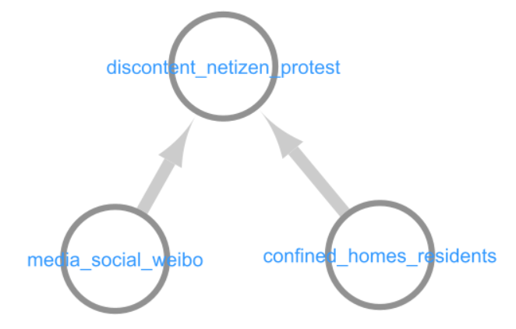
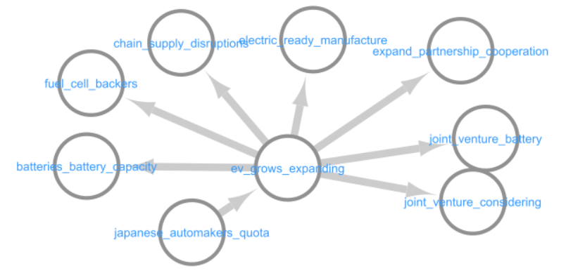
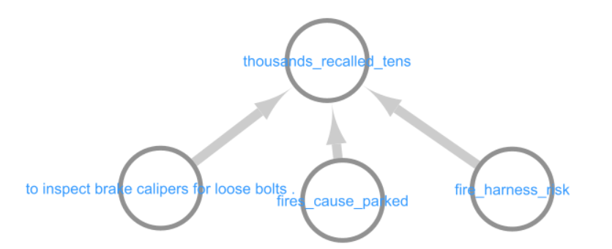
Other exploratory examples:
Japanese automakers follow through and will play a significant role in EV growth
EV growth causes (1) increase in battery charging stations and battery backers, (2) manufacture ready (to ship, and (3) more partnerships & joint ventures in this arena.
Netizen protest caused by social media & confinement of residents
Companies recall their vehicles due to (1) loose bolts inspection, (2) vehicles could catch fire while parked, and (3) risk of electrical part catching fire.
Tesla
Honda
Ford

Slide 13
Use Cases
Summarization:
Collect relations in news across time
Search and monitor on-going trends in news
Hypothesis generation:
Predict outcomes based on current event

Slide 14
Conclusion
We managed to extract causal information from news and represent them in a knowledge graph.
The graph is informative for studying chain of causal events in our examples (E.g. “shortage”, “pandemic”, others).
Upcoming plans:
Improve words appearing in nodes
Expand coverage to more articles
Perform event, temporal, and polarity extraction
Subgraph retrieval for UI
Perform user testing and feedback

Slide 15
CONCLUSION

